Slide 1
Rank Prediction in IndyCar
Bo Peng
https://github.com/DSC-SPIDAL/rankpredictor

Slide 2
Outline
IndyCar Data
Rank Prediction Task and Challenges
Preliminary results

Slide 3
Indycar Data

Slide 4
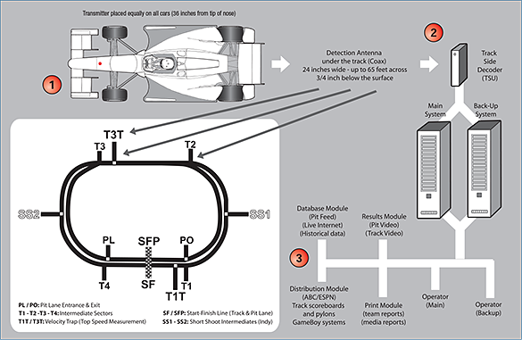
IndyCar Timing and Scoring (https://www.indycar.com/Fan-Info/INDYCAR-101)
Car:A two-way radio transponder, enables LED display on Car of current running order in real time, push-to-pass, and pit stop timing
Track:Multiple detection loop antennas buried trackside decoder records all times to the ten-thousandths of a second.

Slide 5
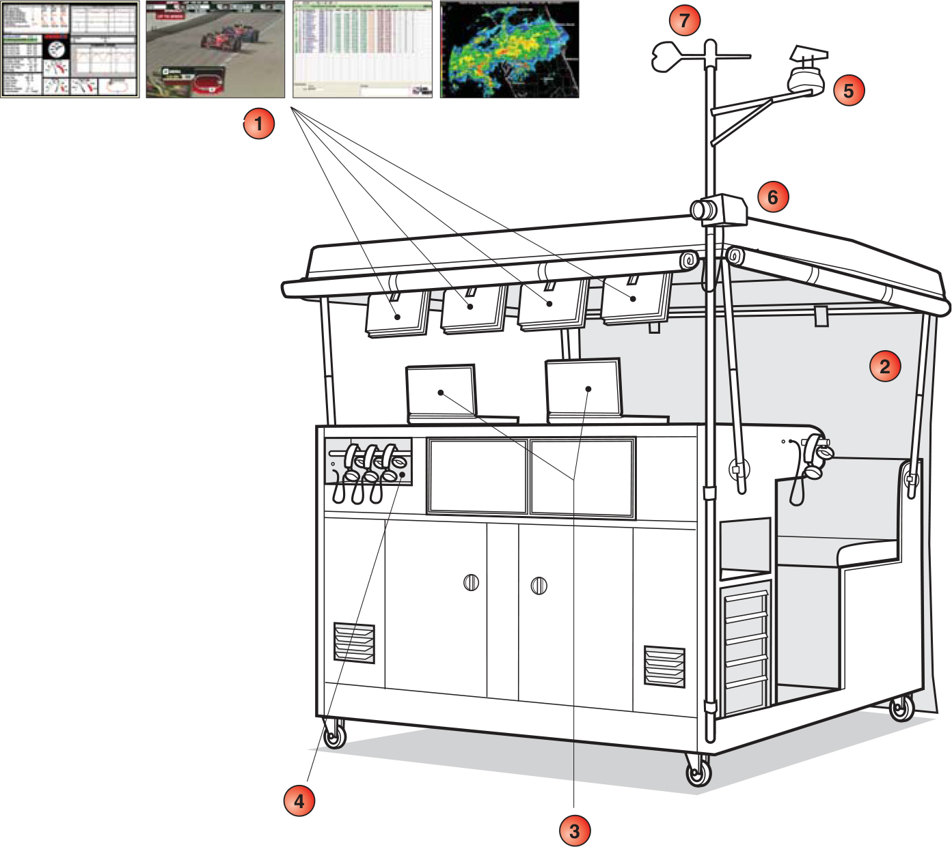
PitBox and Telemetry
Telemetry is a radio device that relays information such as engine, tire, steering and throttle performance to team engineers in the pit box.
to gather data live from their cars as they formulate their race strategy.

Slide 6
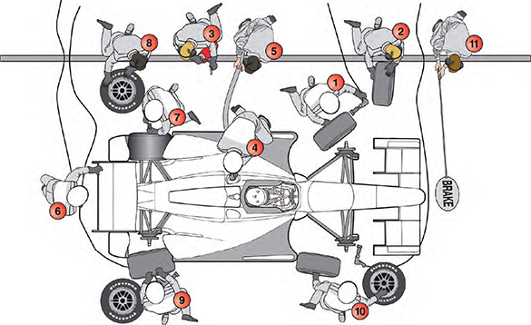
PitStop
During a typical pit stop, the crew will change four Firestone tires, add 18.5 gallons of Speedway E85R and make win adjustments in less than 10 seconds.

Slide 7
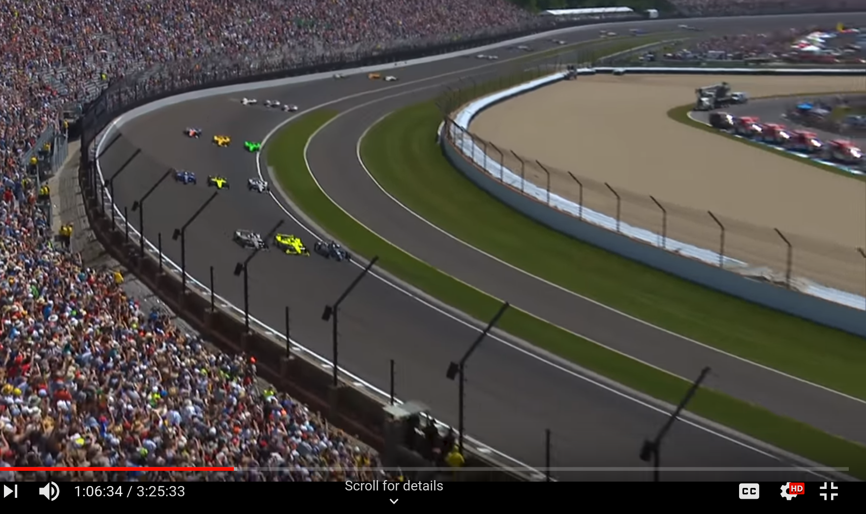
Indy500 Terminology
Warmup
Start Position
Lap time
Elapsed time
Rank
Green/Yellow Flag

Slide 8
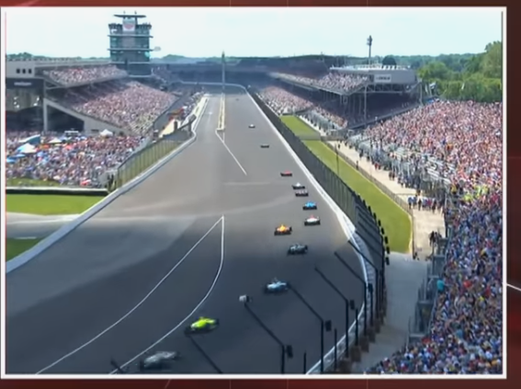

Slide 9
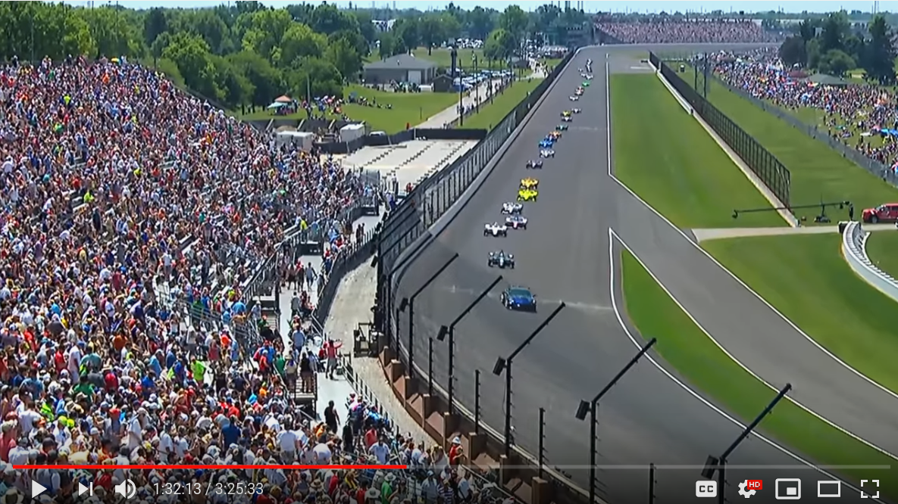

Slide 10
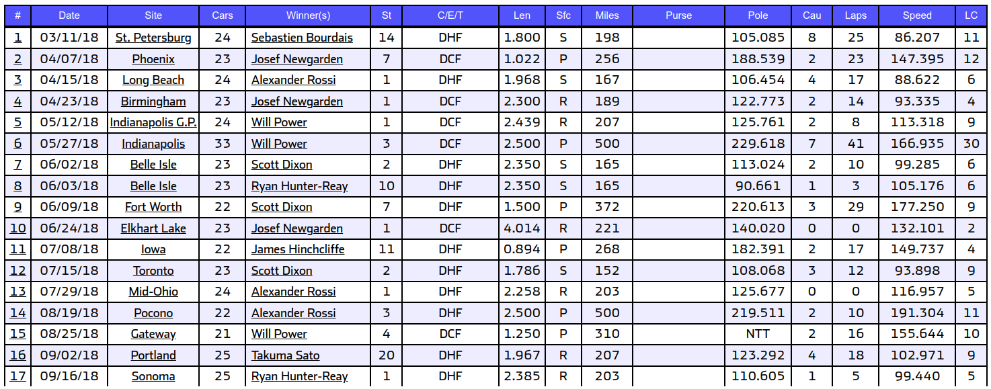
Dataset
timing and score log file of 2018 IndyCar series, which contains 17 events.
Six of them are racing on the oval speedway(Phoenix, Indy500, Texas ,Iowa ,Pocono, Gateway)

Slide 11
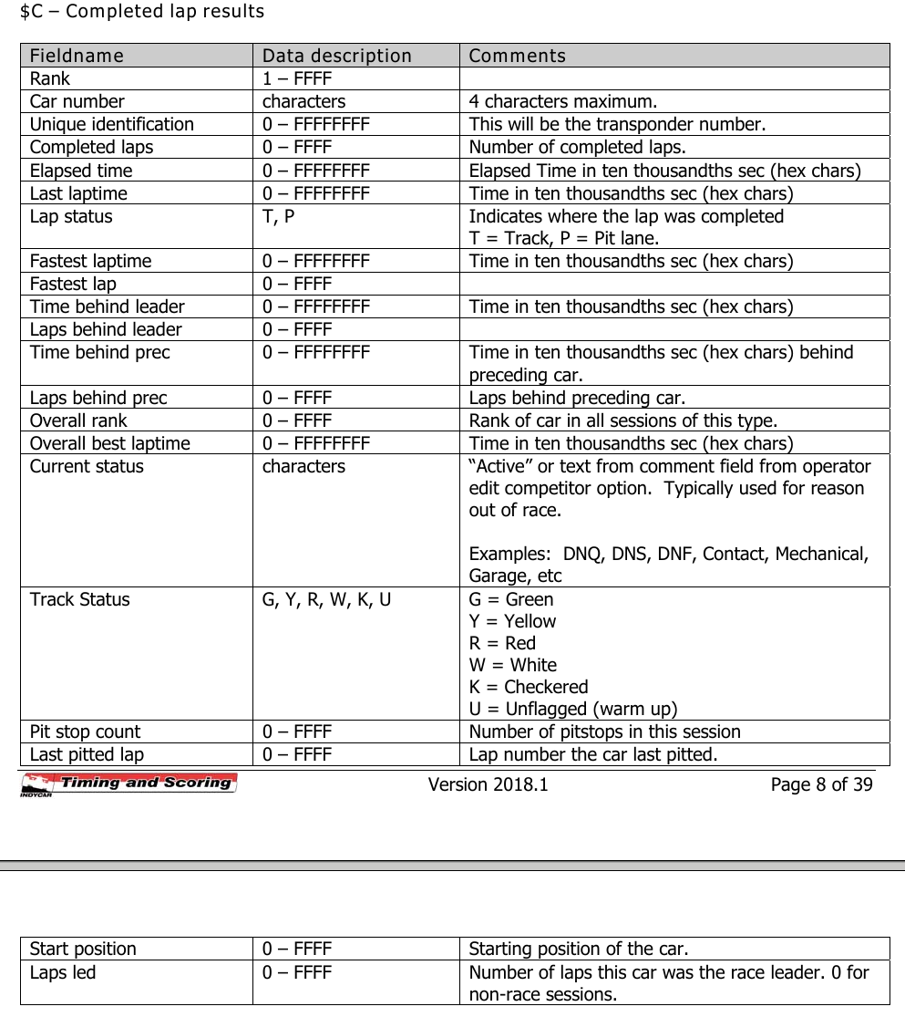
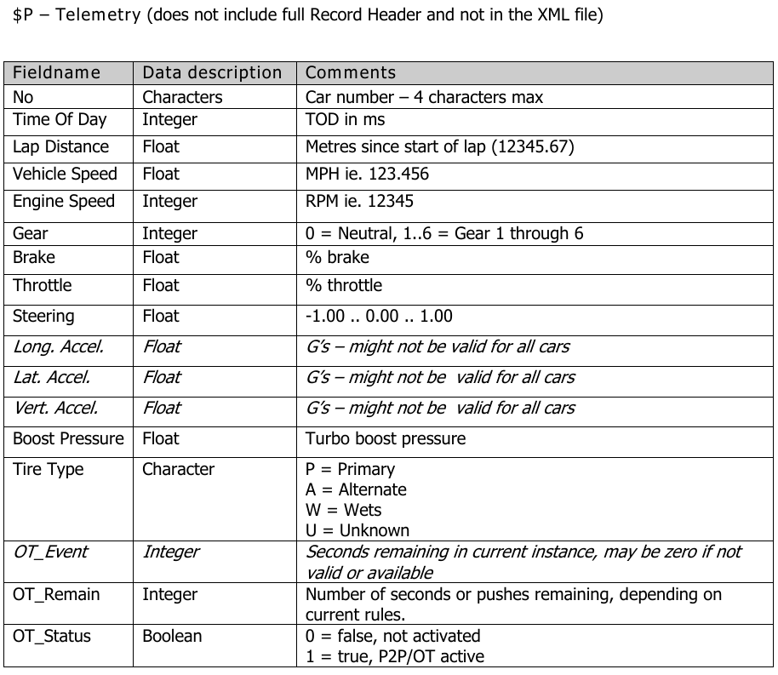

Slide 12
Rank Prediction Task and Challenges

Slide 13
‘Rank’ data
"Race results are based on laps led and crossing order." (Results protocol definition)
"Rank based on best time or race position, updated at each timeline during the race" ($O overall results)
We have verified that the following assumptions are correct:
Rank is calculated by the elapsed time when the car crosses the boundary of sections(timelines). The order of the cars for the same lap number is its rank.
Indy500 has multiple sections; therefore, the rank of a car may change during one lap.
Although real-time position/rank is provided through the LED display on all the racing cars, there are no logged into the log file. We can use a lap-based or timeline/section-based rank only.

Slide 14
What to predict?
Rank prediction for the final lap
Rank prediction for each lap, or a fixed number laps later
Rank prediction for stint/stages

Slide 15
Final Lap Rank(winner) prediction
difficult at the same time due to the stochastic nature of the racing
pitstop
crash
can NOT be evaluated with limited data.
In order to draw a conclusion that a model achieves accuracy of 1/8, it should predict one time correctly on at least eight different races. In practice, more data are needed to get a statistically effective result.

Slide 16
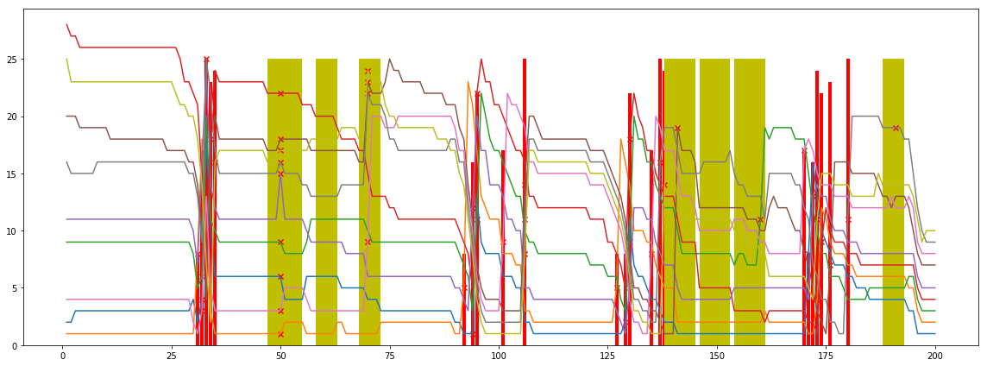
Rank prediction for each lap
Ranks evolving along with the laps. The Final top 10 cars in Indy500 2018. The red bar and the cross marker are pitstops. Yellow bars are caution laps.

Slide 17
Challenges: unvertainty/stochastic
What is the prediction accuracy/error bound?
Bayes error rate is the lowest possible error rate for any classifier of a random outcome (into, for example, one of two categories) and is analogous to the irreducible error

Slide 18
Simulation
Simulation by a simple pitstop model
pitstop window (38 laps max, 8 lap window uniformed distributed)
three types of lap(normal lap, in lap, out lap) modeled by guassian distribution
car_number | in_lap_mean | in_lap_std | norm_lap_mean | norm_lap_std | out_lap_mean | out_lap_std | start_position
0 | 1 | 54.339015 | 8.424845e-01 | 41.743706 | 0.766367 | 66.104833 | 0.730250 | 4
1 | 3 | 54.281610 | 7.251726e-01 | 41.611673 | 0.676782 | 66.911113 | 0.401542 | 8
2 | 4 | 54.295602 | 3.190570e-01 | 41.946153 | 0.770234 | 68.036082 | 0.729633 | 11
3 | 6 | 64.027260 | 8.913270e-01 | 42.018802 | 0.778819 | 55.488440 | 0.238874 | 18

Slide 19
Simulation Result
start from lap 0(120 runs, model on the first 100 runs, test on the last 20 runs)
('mean rank1 accuracy:', 0.56575, array([0.26 , 0.725, 0.865, 0.15 , 0.625, 0.9 , 0.075, 0.425, 0.58 , 0.435, 0.46 , 0.805, 0.93 , 0.055, 0.645, 0.67 , 0.71 , 0.885, 0.49 , 0.625])) ('mean rank1@lap', 1, 'accuracy:', 0.15) ('mean rank1@lap', 15, 'accuracy:', 0.35) ('mean rank1@lap', 32, 'accuracy:', 0.45) ('mean rank1@lap', 50, 'accuracy:', 0.45) ('mean rank1@lap', 150, 'accuracy:', 0.85) ('mean rank1@lap', 200, 'accuracy:', 0.8)

Slide 20
Simulation Result
start from lap 50
('mean rank1 accuracy:', 0.653, array([0.92 , 0.66666667, 0.26 , 0.08666667, 0.76666667, 0.54 , 0.43333333, 0.94 , 0.95333333, 0.42666667, 0.78 , 0.91333333, 0.70666667, 0.93333333, 0.57333333, 0.7 , 0.38666667, 0.95333333, 0.58666667, 0.53333333])) ('mean rank1@lap', 1, 'accuracy:', 1.0) ('mean rank1@lap', 15, 'accuracy:', 1.0) ('mean rank1@lap', 32, 'accuracy:', 1.0) ('mean rank1@lap', 50, 'accuracy:', 1.0) ('mean rank1@lap', 60, 'accuracy:', 0.5) ('mean rank1@lap', 110, 'accuracy:', 0.65) ('mean rank1@lap', 150, 'accuracy:', 0.7) ('mean rank1@lap', 200, 'accuracy:', 0.7)

Slide 21
Challenges: model capacity
Which model is able to modeling the uncertainty?
lstm/rnn is a deterministic model, it can not model the stochastic part of the data
ctrnn? todo

Slide 22
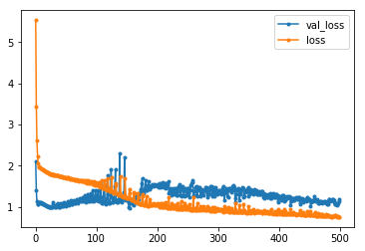
Challenges: data complexity
How much data is needed to train a stable model?
todo
LSTM training on hundreds of timeseries is prone to overfitting. (laptime series predition)

Slide 23
Prelimiary Results

Slide 24
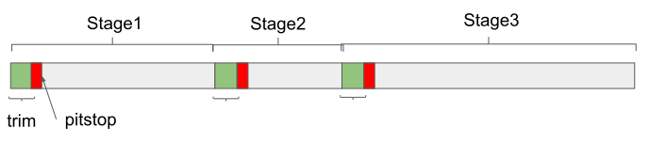
Rank Prediction on stint
we define our task to be the rank change prediction on stage dataset. In IndyCar, ‘stint’ refers to the period of driving between pit stops, similar to the term ‘stage.’
When a car goes into the pit lanes, the model can predict how well the car will perform in the next stage, whether it would lose or gain in rank. With the support of this prediction model, it potentially enables the team to evaluate different strategies, such as when to pit stop.

Slide 25
Dataset
Event | Records
Phoenix | 114
Indy500 | 225
Texas | 127
Iowa | 109
Pocono | 126
Gateway | 104
Stage Dataset of Six Paved Racing in 2018 IndyCar series
Extract from these events, we get a stage dataset with 805 stage records

Slide 26
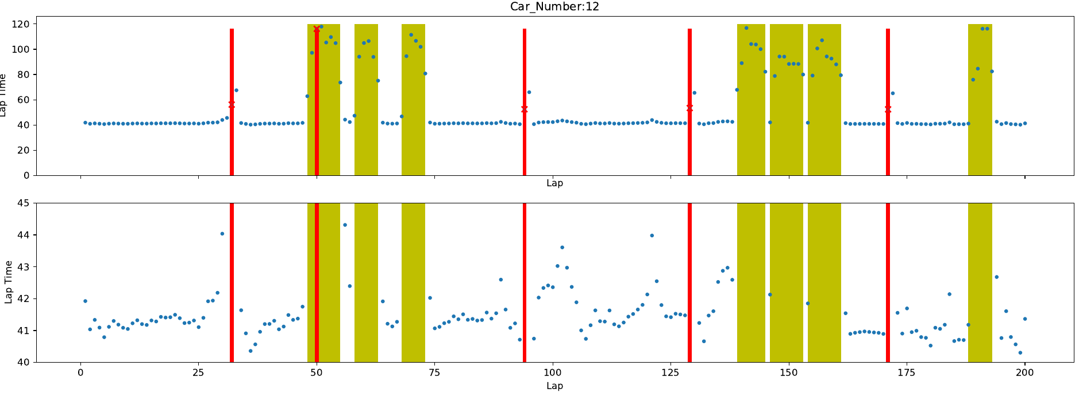
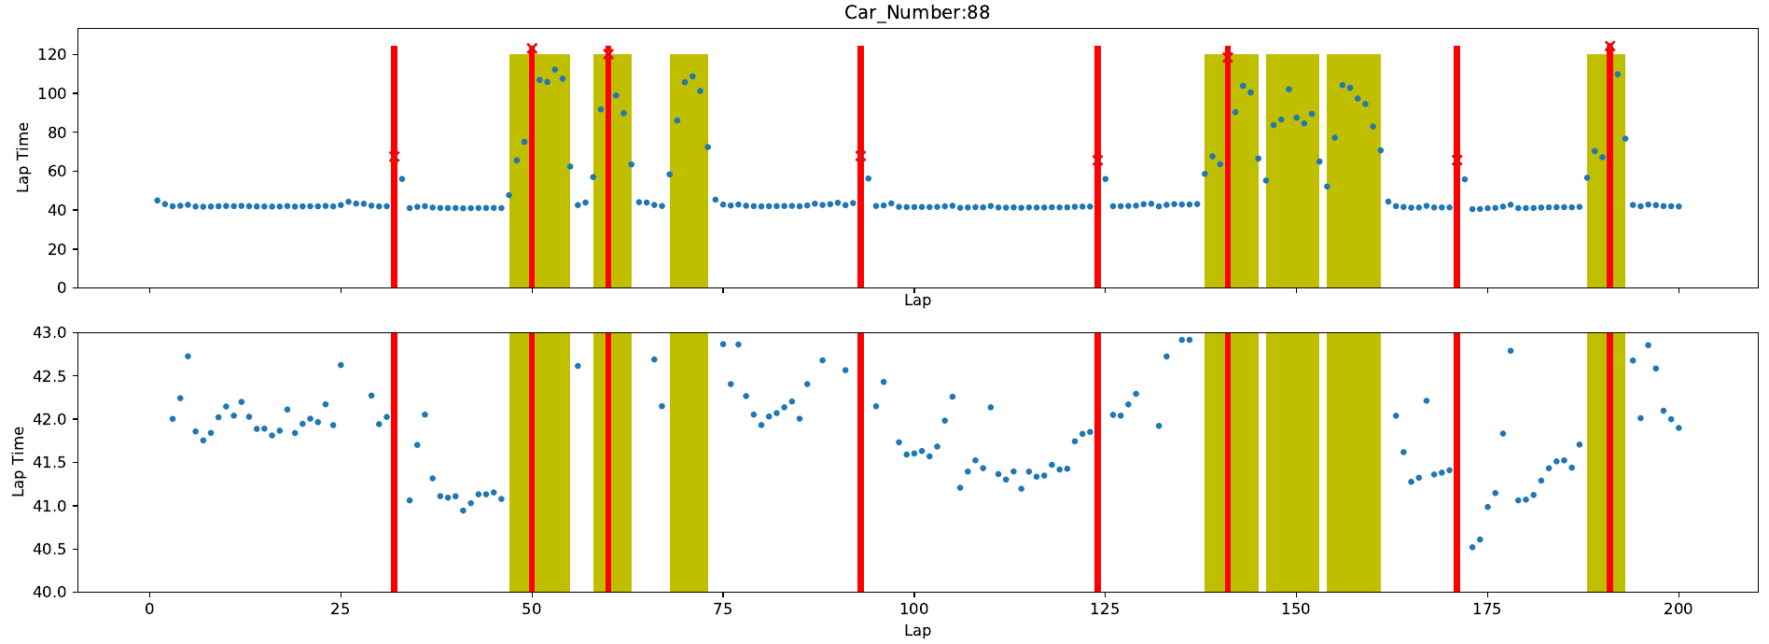
DataAnalysis
IndyCar. Car#12 finished in rank 1 and #88 finished in rank 14. Yellow bar indicates caution laps and red bar indicates pit stop.
no consistent pattern can be observed. Instead of modeling the trend of lap time, we extract mean and std as features of the lap time within a stage.

Slide 27
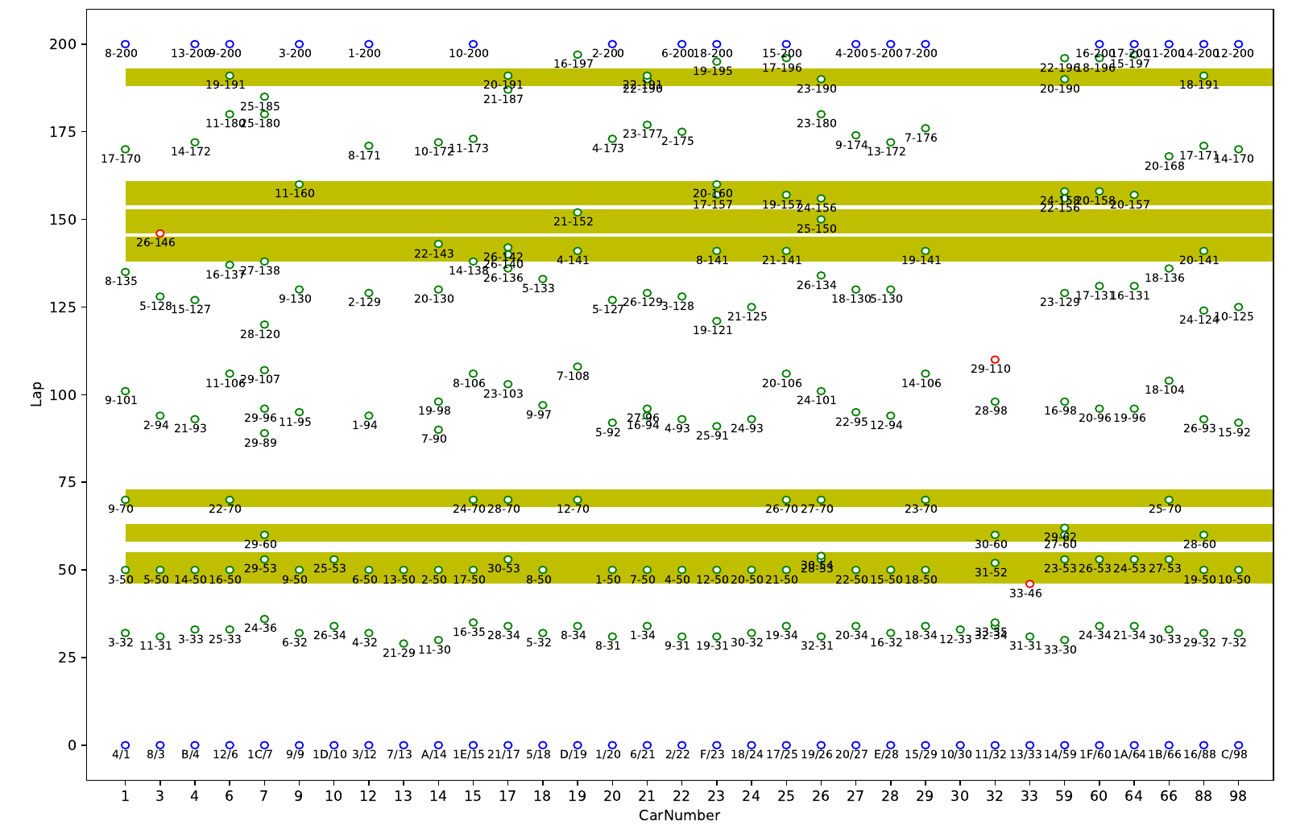
PitStop
IndyCar (2018-Indy500, green circle denotes pitstop labeled with rank-lap, blue circles are the start/end position)
the dynamic of the pitstops.

Slide 28
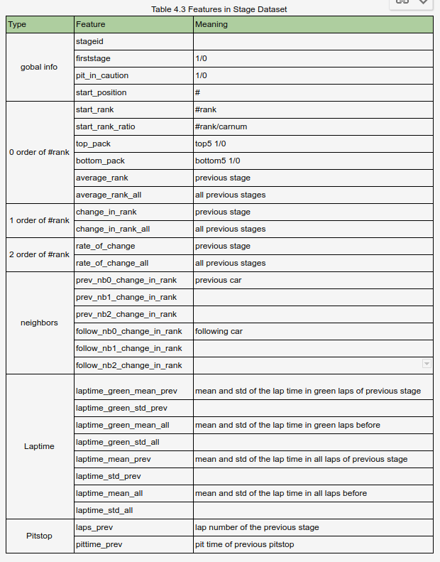
Features
Features for each stage including the initial start position, start rank, change of rank, rate of changes, lap time, pitstop related features, and information of its neighbors.

Slide 29
Baselines
CurRank: predict the end rank with the current start rank of the stage, i.e., means change is always zero.
AvgRank: predict the end rank with the average rank changes in previous stages.
Dice: predict the rank change by randomly throw dice, which follows the distribution of the training data. For the classification task, it is a three facets dice(+,0,-).

Slide 30
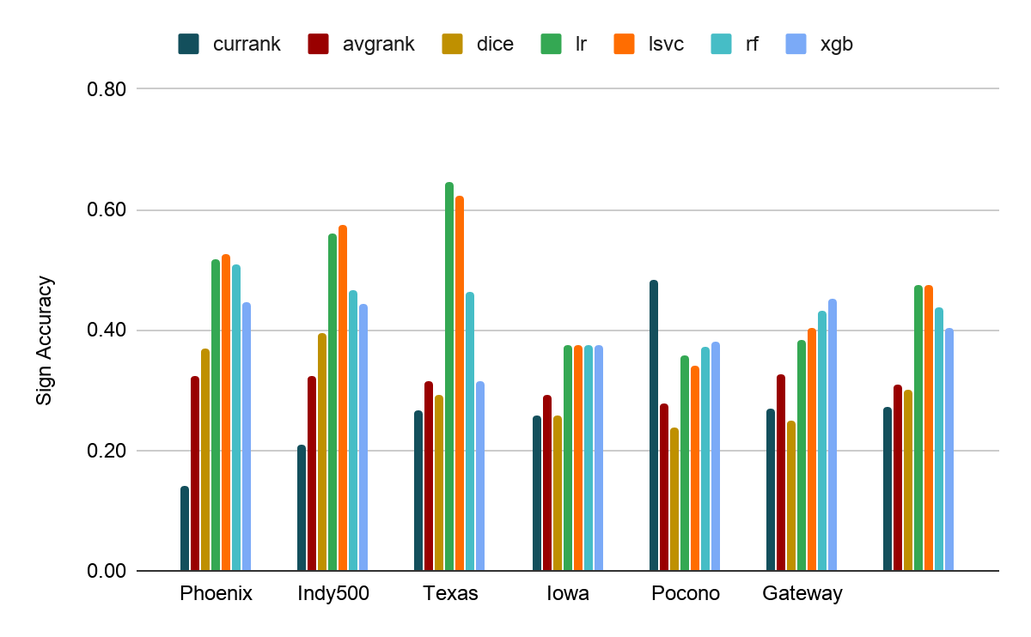
Results
four models in the task of the sign of rank change prediction, including logistic regression(lr), linear SVM(lsvc), random forest(rf), and gradient boosting tree(xgb).
there is one exception that CurRank is the best in Pocono, where more than 50% of stages have no rank changes.

Slide 31
Feature Analysis
The top 20 most salient features selected on the sign of rank change task are:
start_rank, pit_in_caution, average_rank, stageid, start_rank_ratio, bottom_pack, firststage, top_pack, eventid, laptime_std_all, average_rank_all, laptime_green_mean_all, laptime_green_std_all, follow_nb2_change_in_rank, car_number, rate_of_change_all, pittime_prev, prev_nb0_change_in_rank, laps_after_last_pitstop, laptime_mean_prev,

Slide 32
Q&A

